Slide 1

Exam AZ-304: Microsoft Azure Architect Design Crash Course
Tim Warner

Slide 2


Tim Warner
Based in Nashville, TN, US
MCT, MVP
Twitter: @TechTrainerTim
Badge: timw.info

Slide 3
Day 1 of 2 Agenda
Introduction
Blah
Exam AZ-303 strategy

Slide 4
Day 2 of 2 Agenda
Content catch-up
Blah
Exam AZ-303 Strategy

Slide 5
Course Materials
timw.info/az304

Slide 6
A Different Kind of Training
Let's avoid slide show fatigue
We'll learn by doing – at least 80 percent demo
Case study approach
This is an expert certification, so we will move quickly and assume intermediate-level Azure skills
5-minute break at midpoint
I’m here to answer your questions – take advantage of this!
Use the Q&A panel

Slide 7
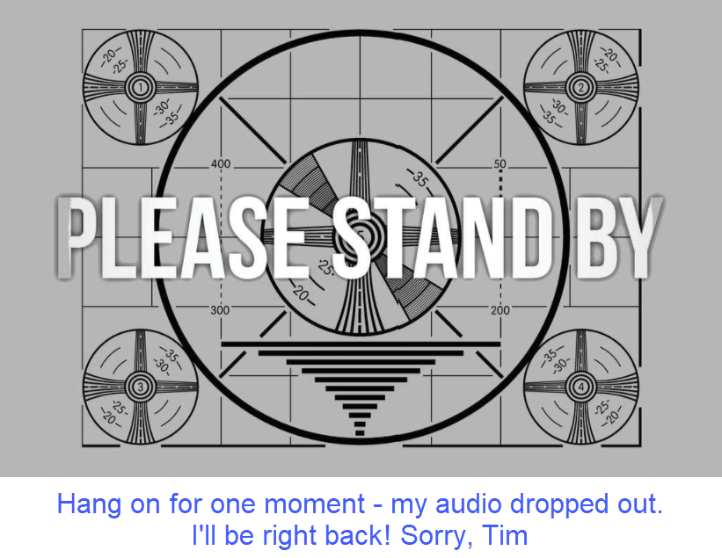
If my audio drops out, you'll see…

Slide 8

Session Recordings

Slide 9
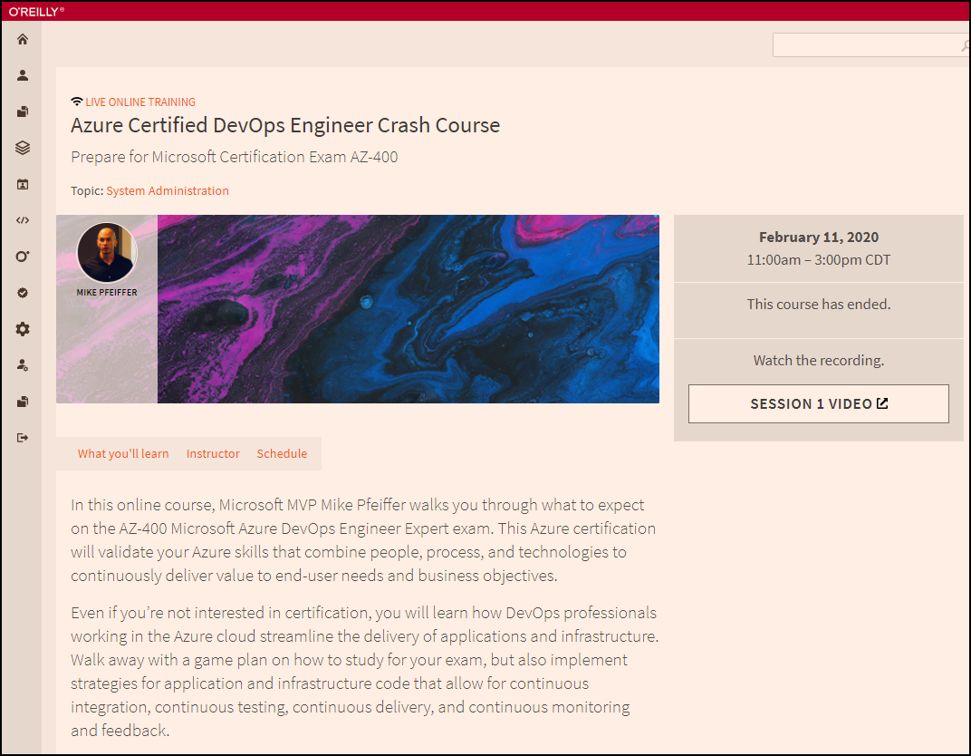
Session Recordings

Slide 10

Session Recordings

Slide 11
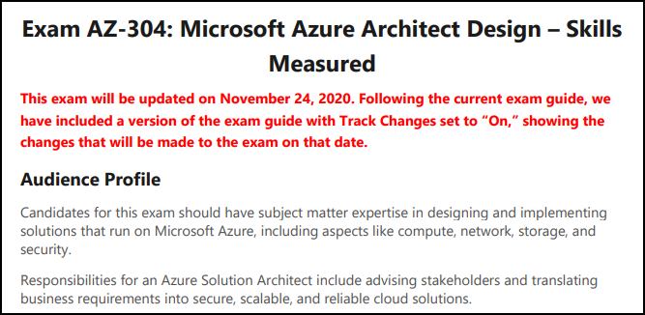
AZ-304 Changes: Nov 24, 2020
Many more changes than AZ-303

Slide 12
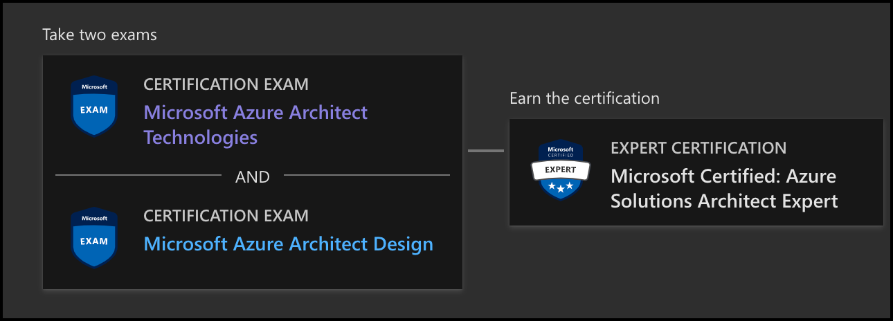
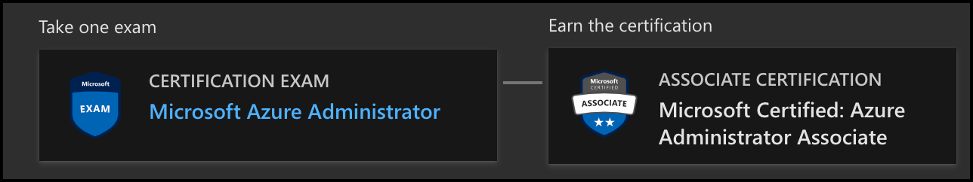
Azure Architect Facts and Tips

Slide 13
Tim's Certification Study Pyramid
Interdependence
Content knowledge
Practical application
Test-taking skills

Slide 14
Thank you!
Course materials: timw.info/az304
Twitter: @TechTrainerTim
Work: timw.info/ps
Web: TechTrainerTim.com

Slide 15
Authentication

Slide 16

Tenant vs. Subscription

Slide 17

Hybrid Identity

Slide 18

Passthrough Authentication

Slide 19

Seamless Single Sign-on

Slide 20
Authorization and Governance

Slide 21

Azure Management Scopes
/ Tenant Root

Slide 22
Azure Storage

Slide 23
Storage Account Replication
1
3
3
2
LRS
ZRS

Slide 24
Storage Account Replication
3
3
GRS/RA-GRS

Slide 25
Storage Account Replication
1
3
1
3
2
2
GZRS – RA/GZRS

Slide 26

Always Encrypted

Slide 27

Data Pipelines

Slide 28
Monitoring

Slide 29

Azure Diagnostics

Slide 30

Log Analytics

Slide 31

Sentinel

Slide 32
Migration and Disaster Recovery

Slide 33

Azure Backup

Slide 34

Azure Site Recovery

Slide 35
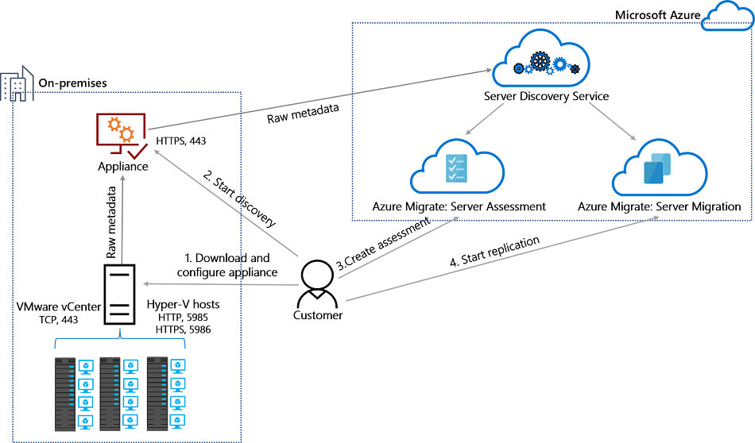
Azure Migrate

Slide 36
Azure Compute

Slide 37

VM Scale Sets

Slide 38
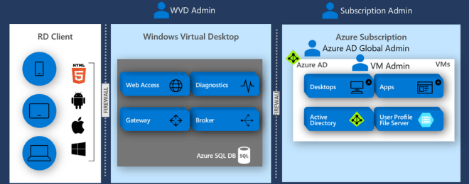
Windows Virtual Desktop (WVD)
timw.info/travis

Slide 39

Availability Set

Slide 40

Availability Zone

Slide 41
Load Balancing

Slide 42

VM Networking

Slide 43

Load Balancing

Slide 44

VNet Peering

Slide 45

Hybrid Networking

Slide 46

Network Virtual Appliance

Slide 47

Azure Load Balancer

Slide 48

Application Gateway

Slide 49

Traffic Manager

Slide 50

Front Door Service

Slide 51
Containers

Slide 52


Docker Container Lifecycle
https://timw.info/3635f

Slide 53
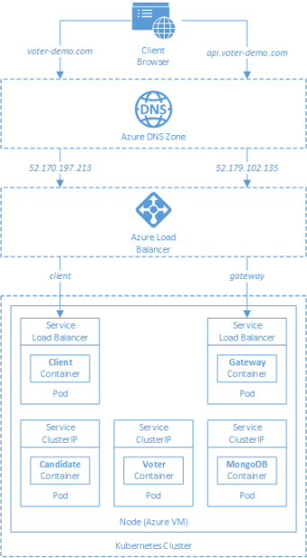
AKS

Slide 54
App Architecture

Slide 55

Event Architecture

Slide 56

Event Architecture

Slide 57
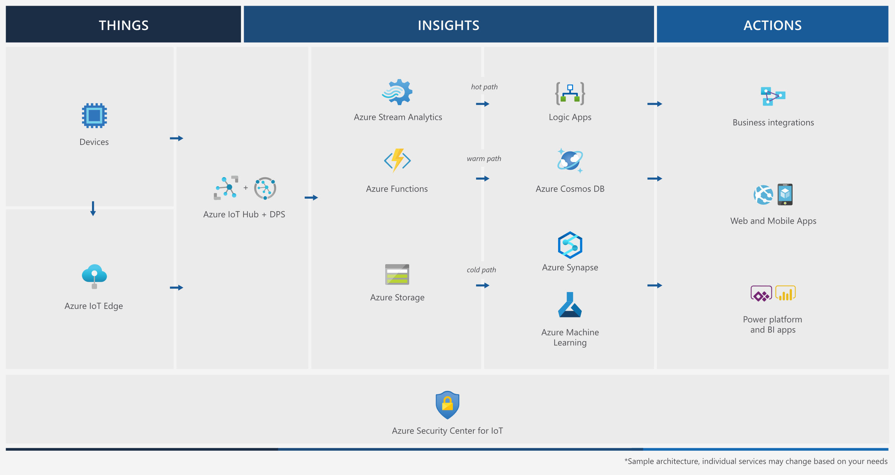
Event Architecture

Slide 58
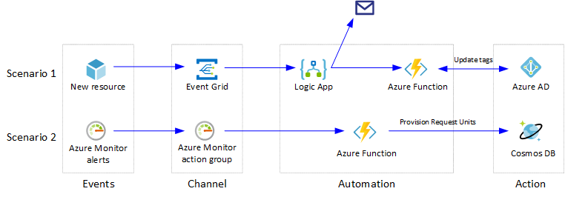
Event Architecture

Slide 59
Exam AZ-304 Item Types

Slide 60

Multiple Choice

Slide 61
Repeated Scenario
You need to move an Azure VM to another hardware host.
Solution: You redeploy the VM.
Does this solution meet the goal?
Yes
No

Slide 62

Select and Place

Slide 63

Build List and Reorder

Slide 64

Active Screen/Fill in the Blank

Slide 65

Case Study

Slide 66






Performance-Based Lab

Slide 67
Microsoft Online Testing

Slide 68
Microsoft Online Testing Process
timw.info/online

Slide 69

Microsoft Online Testing Process

Slide 70

Microsoft Online Testing Process

Slide 71

Microsoft Online Testing Process

Slide 72

Microsoft Online Testing Process

Slide 73

Microsoft Online Testing Process

Slide 74

Microsoft Online Testing Process

Slide 75

Microsoft Online Testing Process

Slide 76
AZ-304 Exam Strategy
Focus your skills accordingly:
60 percent Azure portal
20 percent Azure PowerShell
10 percent Azure CLI
10 percent KQL
Expect performance-based labs, but be thankful if you don't see 'em

Slide 77
Thank you!
Course materials: timw.info/az304
Twitter: @TechTrainerTim
Work: timw.info/ps
Web: TechTrainerTim.com

